Slide 1




Are likely 2024 presidential candidates deleting their tweets?
Presented By:
Himarsha R Jayanetti
PhD Student
Department of Computer Science
Old Dominion University, Norfolk, Virginia
@HimarshaJ @WebSciDL
Created as a course requirement for CS895 Web Archiving Forensics (by Dr. Michael Nelson), Fall 2020

Slide 2
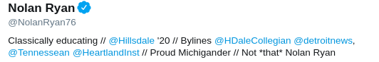
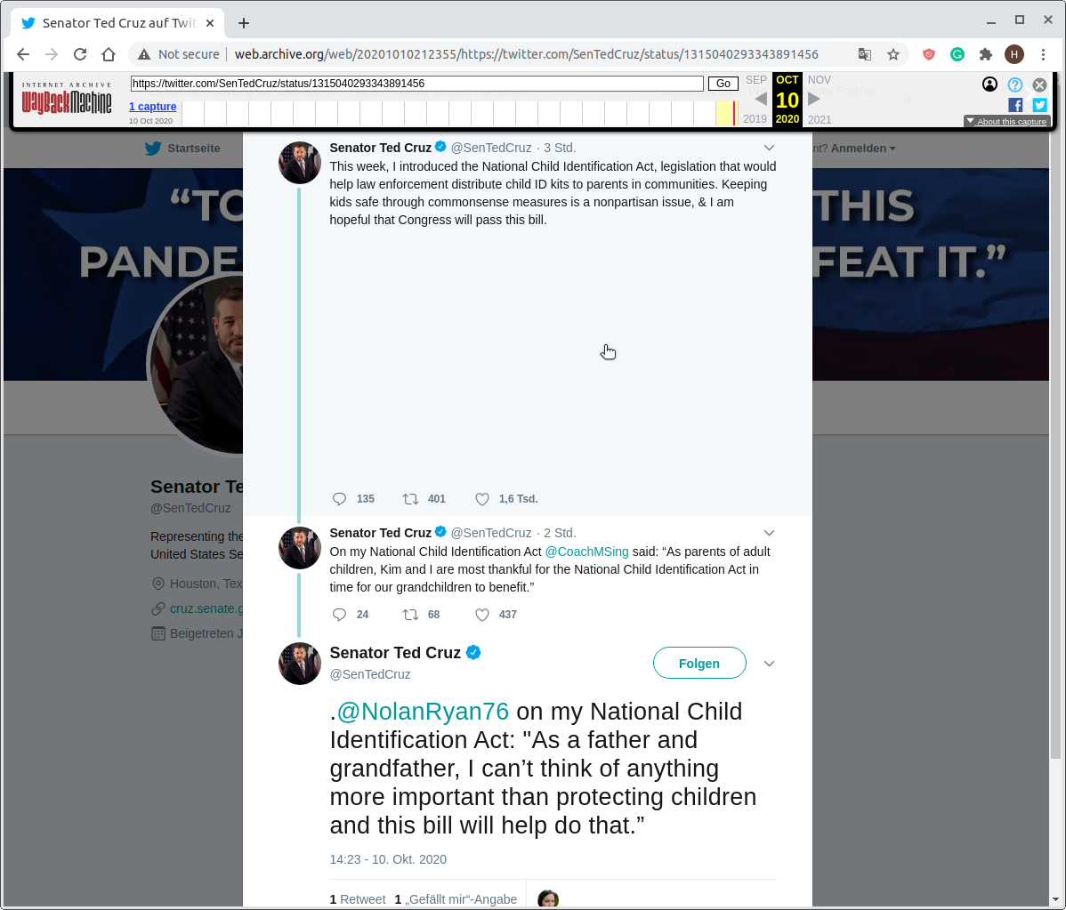
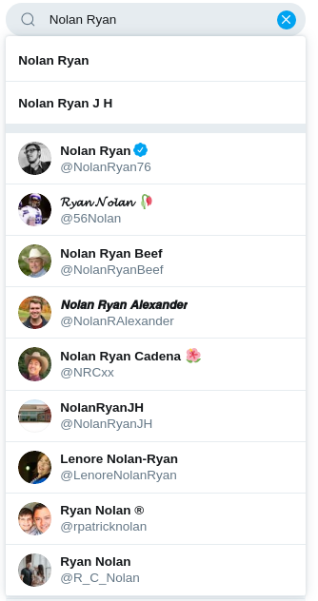
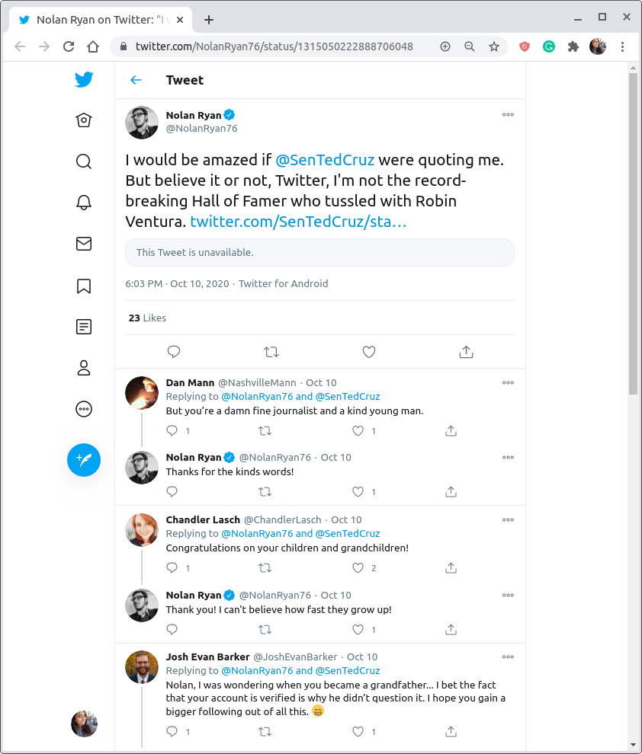
Will the Real Nolan Ryan Please Stand Up?
Search results for Nolan Ryan
http://web.archive.org/web/20201010212355/https://twitter.com/SenTedCruz/status/1315040293343891456
https://twitter.com/NolanRyan76/status/1315050222888706048
News article: http://hillsdalecollegian.com/2020/10/will-the-real-nolan-ryan-please-stand-up/

Slide 3
Potential Presidential Candidates for 2024 Election
Name | Position | Party | Twitter Handle
 |  |  | Official | Personal
Mike Pence | Vice president of the United States | Republican | @VP | @Mike_Pence
Greg Abbott | Governor of Texas | Republican | @GovAbbott | @GregAbbott_TX
Tom Cotton | U.S. senator from Arkansas | Republican | @SenTomCotton | @TomCottonAR
Ted Cruz | U.S. senator from Texas | Republican | @SenTedCruz | @tedcruz
Ron DeSantis | Governor of Florida | Republican | @GovRonDeSantis | @RonDeSantisFL
Mike DeWine | Governor of Ohio | Republican | @GovMikeDeWine | @MikeDeWine
Nikki Haley | Former ambassador to the United Nations | Republican | @AmbNikkiHaley * | @NikkiHaley
Larry Hogan | Governor of Maryland | Republican | @GovLarryHogan | @LarryHogan
HawleyMO | U.S. senator from Missouri | Republican | @HawleyMO
https://ballotpedia.org/Presidential_candidates,_2024, *Nikki Haley’s official account is archived and since her retirement as the ambassador.

Slide 4
Potential Presidential Candidates for 2024 Election Continued
Name | Position | Party | Twitter Handle
 |  |  | Official | Personal
Mike Lee | U.S. senator from Utah | Republican | @SenMikeLee | @mikeleeforutah
Mike Pompeo | U.S. secretary of state | Republican | @SecPompeo | @mikepompeo
Marco Rubio | U.S. senator from Florida | Republican | @SenRubioPress | @marcorubio
Ben Sasse | U.S. senator from Nebraska | Republican | @SenSasse | @BenSasse
Rick Scott | U.S. senator from Florida | Republican | @SenRickScott | @ScottforFlorida
Tim Scott | U.S. senator from South Carolina | Republican | @SenatorTimScott | @Votetimscott, @TimScottSC
Kamala Harris | U.S. senator from California* | Democratic | @SenKamalaHarris | @KamalaHarris
Cory Booker | U.S. senator from New Jersey | Democratic | @SenBooker | @CoryBooker
Amy Klobuchar | U.S. senator from Minnesota | Democratic | @SenAmyKlobuchar | @amyklobuchar
https://ballotpedia.org/Presidential_candidates,_2024, *Kamala Harris is the US Vice President-elect 2020

Slide 5
How to Find Deleted Tweets?
Step 01: It’s Important That Your Account Is Well-Archived
Step 02: Tweet Data From the Live Web
Step 03: TimeMaps for Each User Account
Step 04: Extracting the Tweet Data From the Mementos
Step 05: Comparing the Tweet IDs Extracted From the Live Web and Archive
Step 06: Verifying the Deleted Tweets

Slide 6
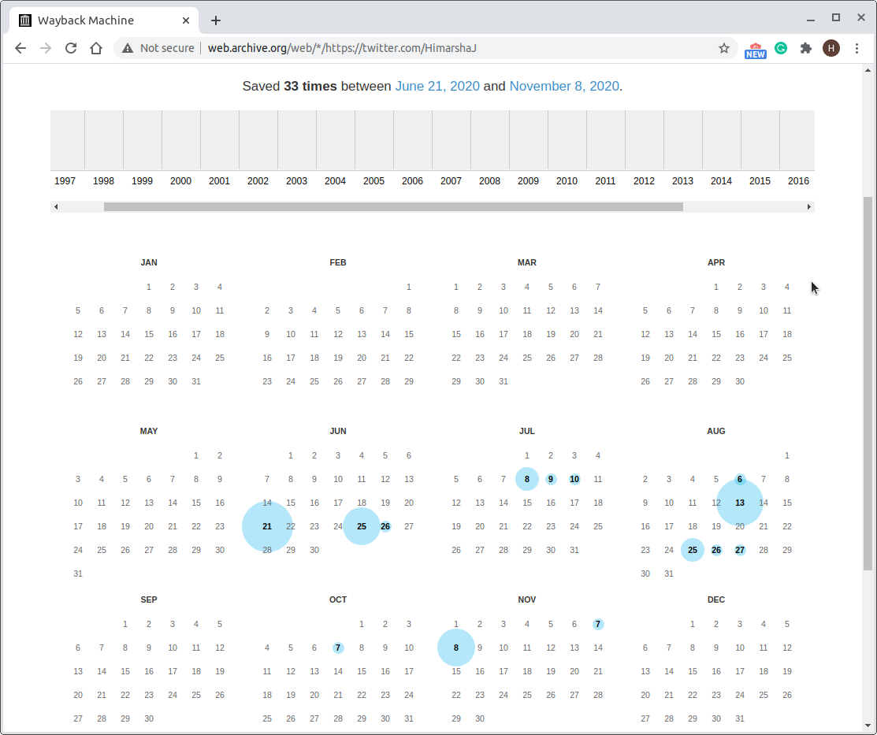
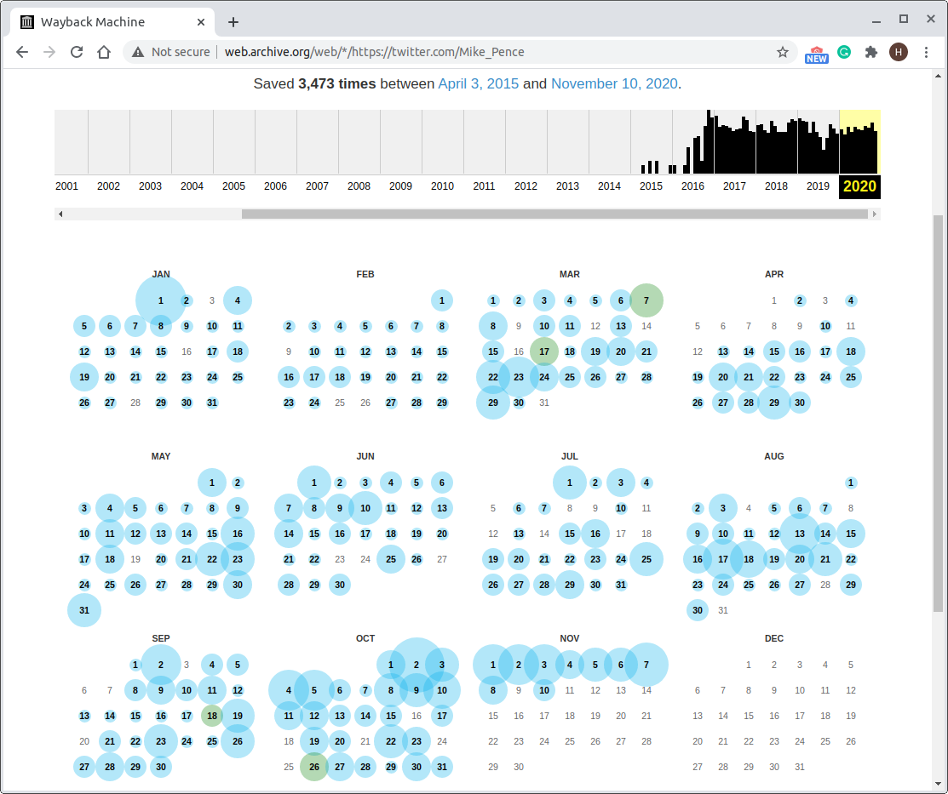
It’s Important That Your Account Is Well-Archived
http://web.archive.org/web/*/https://twitter.com/HimarshaJ
http://web.archive.org/web/*/https://twitter.com/Mike_Pence

Slide 7
How to Find Deleted Tweets?
Step 01: It’s Important That Your Account Is Well-Archived
Step 02: Tweet Data From the Live Web
Step 03: TimeMaps for Each User Account
Step 04: Extracting the Tweet Data From the Mementos
Step 05: Comparing the Tweet IDs Extracted From the Live Web and ArchiveStep
06: Verifying the Deleted Tweets

Slide 8
Tweet Data From the Live Web
Tool used: twintproject/twint (Twitter Intelligence Tool)
$twint -u Mike_Pence --timeline --since 2020-10-01
Collected data from the live web since Oct 1, 2020 until Nov 9, 2020.
--timeline flag contains tweets, retweets, and replies.
Output:
Tweet Id
Conversation Id
Created_at
User Id
Username
Name
Tweet
Engagement Information, etc. (36 different fields)

Slide 9
How to Find Deleted Tweets?
Step 01: It’s Important That Your Account Is Well-Archived
Step 02: Tweet Data From the Live Web
Step 03: TimeMaps for Each User Account
Step 04: Extracting the Tweet Data From the Mementos
Step 05: Comparing the Tweet IDs Extracted From the Live Web and Archive
Step 06: Verifying the Deleted Tweets

Slide 10
TimeMaps for Each User Account
def get_timemap(UN):
cmd = ("curl -s http://memgator.cs.odu.edu/timemap/link/https://twitter.com/%s | grep 'memento'" % (UN))
a = os.popen(cmd)
timemap = a.readlines()
URIM_list = []
filename = "%s_timemap.txt" % UN
with open(filename, "a") as f:
for item in timemap:
URIM = item.split("; ")[0].strip("<>")
date = re.findall('"([^"]*)"', item.split("; ")[2])[0]
start_date = datetime.strptime("Sun, 01 Oct 2020 00:00:00 GMT", '%a, %d %b %Y %H:%M:%S GMT')
date = datetime.strptime(date, '%a, %d %b %Y %H:%M:%S GMT')
if date > start_date:
URIM_list.append(URIM)
f.write(URIM + "\n")
return URIM_list
This data was collected data from MemGator on Nov 9, 2020.

Slide 11
How to Find Deleted Tweets?
Step 01: It’s Important That Your Account Is Well-Archived
Step 02: Tweet Data From the Live Web
Step 03: TimeMaps for Each User Account
Step 04: Extracting the Tweet Data From the Mementos
Step 05: Comparing the Tweet IDs Extracted From the Live Web and Archive
Step 06: Verifying the Deleted Tweets

Slide 12
Extracting the Tweet Data From the Mementos
def get_archived_tweets(UN, URIM_list):
for URIM in URIM_list:
response = requests.get(URIM)
soup = bs4.BeautifulSoup(response.text,"html.parser")
match = soup.select('div.js-stream-tweet')
for tag in match:
if tag.has_attr("data-tweet-id"):
if tag.has_attr("data-retweet-id"):
id =tag["data-retweet-id"]
else:
id =tag["data-tweet-id"]
timestamp = tag.find("span", {"class": "js-short-timestamp"})
time = timestamp["data-time"]

Slide 13
HTML Snippets From the Memento
<div class="tweet js-stream-tweet js-actionable-tweet js-profile-popup-actionable dismissible-content
original-tweet js-original-tweet
"data-tweet-id="1324427119984844802" data-item-id="1324427119984844802" data-permalink-path="/HimarshaJ/status/1324427119984844802"
data-conversation-id="1324427119984844802" data-tweet-nonce="1324427119984844802-83708724-4305-41b9-968c-09961654345d"
data-tweet-stat-initialized="true" data-screen-name="HimarshaJ" data-name="Himarsha Jayanetti" data-user-id="1159091256766713856" data-you-follow="false" data-follows-you="false" …………………………>
For Tweets/Quote tweets:
Extracted the Tweet ID
<div class="tweet js-stream-tweet js-actionable-tweet js-profile-popup-actionable dismissible-content
original-tweet js-original-tweet
tweet-has-context
"data-tweet-id="1324257840685551621" data-item-id="1324257840685551621" data-permalink-path="/debsherlock/status/1324257840685551621" data-conversation-id="1324257840685551621" data-tweet-nonce="1324257840685551621-d2ca88cc-9cc3-463b-9691-43c62798df94" data-tweet-stat-initialized="true" data-retweet-id="1324320758651387905" data-retweeter="HimarshaJ" data-screen-name="debsherlock" data-name="Dr Deborah Wilson" data-user-id="30960879" data-you-follow="false" data-follows-you="false"…………………………>
For Retweets:
Extracted the Retweet ID
URL Structure: twitter.com/HimarshaJ/status/{19DigitNumericID}

Slide 14
How to Find Deleted Tweets?
Step 01: It’s Important That Your Account Is Well-Archived
Step 02: Tweet Data From the Live Web
Step 03: TimeMaps for Each User Account
Step 04: Extracting the Tweet Data From the Mementos
Step 05: Comparing the Tweet IDs Extracted From the Live Web and Archive
Step 06: Verifying the Deleted Tweets

Slide 15
Comparing the Tweet IDs Extracted From the
Live Web and Archive
To find the deleted tweets, I compared the tweet IDs extracted from the live web and the archive.
$comm -13 Mike_Pence_live.id Mike_Pence_archived.id > Mike_Pence_deleted.id
Mike_Pence_live.id:
Sorted list of tweet IDs present in the live web since Oct 1, 2020.
Mike_Pence_archived.id:
Sorted list of tweet IDs present in the archive since Oct 1, 2020.

Slide 16
How to Find Deleted Tweets?
Step 01: It’s Important That Your Account Is Well-Archived
Step 02: Tweet Data From the Live Web
Step 03: TimeMaps for Each User Account
Step 04: Extracting the Tweet Data From the Mementos
Step 05: Comparing the Tweet IDs Extracted From the Live Web and Archive
Step 06: Verifying the Deleted Tweets

Slide 17
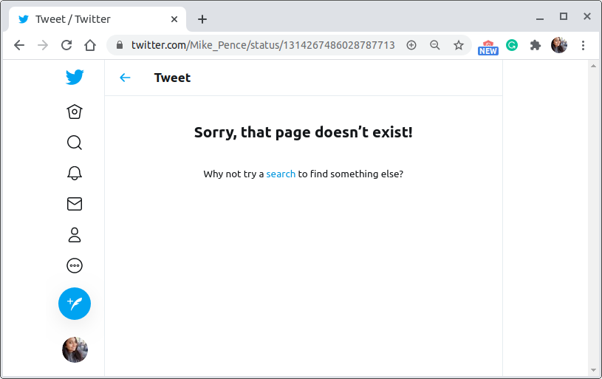
Twitter’s New UI: Soft 404s
New Twitter UI returns soft 404s for pages that don’t exist.
https://twitter.com/Mike_Pence/status/1314267486028787713
$ curl -ILs https://twitter.com/Mike_Pence/status/1314267486028787713 | grep "^HTTP\|content-type:\|date:\|expiry\|last-modified:"
HTTP/2 200
content-type: text/html; charset=utf-8
date: Wed, 11 Nov 2020 07:05:06 GMT
expiry: Tue, 31 Mar 1981 05:00:00 GMT
last-modified: Wed, 11 Nov 2020 07:05:06 GMT

Slide 18
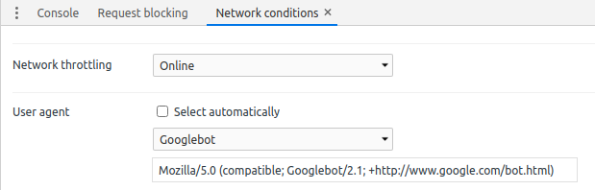
To the Rescue, Here I Am - “Googlebot”
We can still access the Twitter’s old UI by setting the UA as “Googlebot” in the browser incognito mode
https://ws-dl.blogspot.com/2020/07/2020-07-15-twitter-was-already.html
$ curl -A "Googlebot" -ILs https://twitter.com/Mike_Pence/status/1314267486028787713 | grep "^HTTP\|content-type:\|date:\|expiry\|last-modified:"
HTTP/2 404
content-type: text/html;charset=utf-8
date: Wed, 11 Nov 2020 07:05:49 GMT
last-modified: Wed, 11 Nov 2020 07:05:49 GMT
“Sun is shining” - Bob Marley

Slide 19
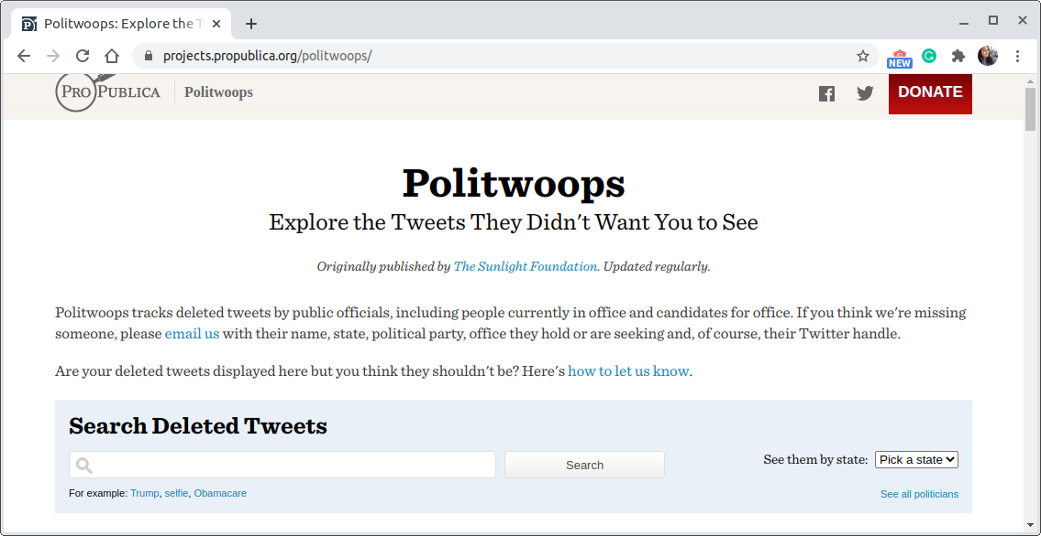
Manually Verifying the Possibly Deleted Tweets
Re-checking the live web URL.
CDX API to get the other URL variations, using MemGator to get the archived copies for the individual tweets having different URL variations, and checking the content.
Verifying through other services like Politwoops.
https://projects.propublica.org/politwoops/
Throughout the process, I tried to identify the reasons for deleting the discovered deleted tweets.

Slide 20
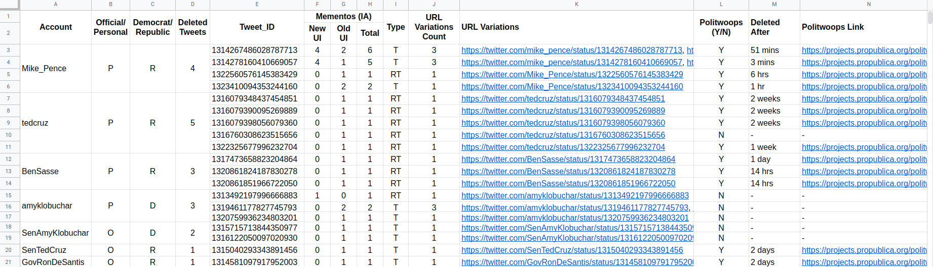
Dataset
https://docs.google.com/spreadsheets/d/1--sKSlc0tt8vQkf_jsgBfXuuaw_NcsmgLADQ7w-Jv-Q/edit?usp=sharing
More Info: https://docs.google.com/document/d/1a9FQo1DAl9AOApAqJVvFKj9OR54rHiWU5rDad87uayM/edit?usp=sharing

Slide 21
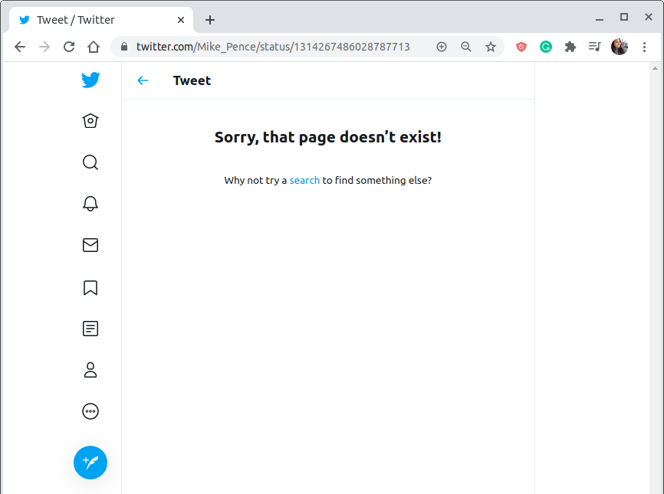
Why Would Someone Delete a Tweet?
Category 1: Replaced with another tweet.
Category 2: RT of something that you don't control.
Category 3: UnRTd.
Category 4: Inaccurate information.
Category 5: Other/unknown.
https://twitter.com/Mike_Pence/status/1314267486028787713

Slide 22
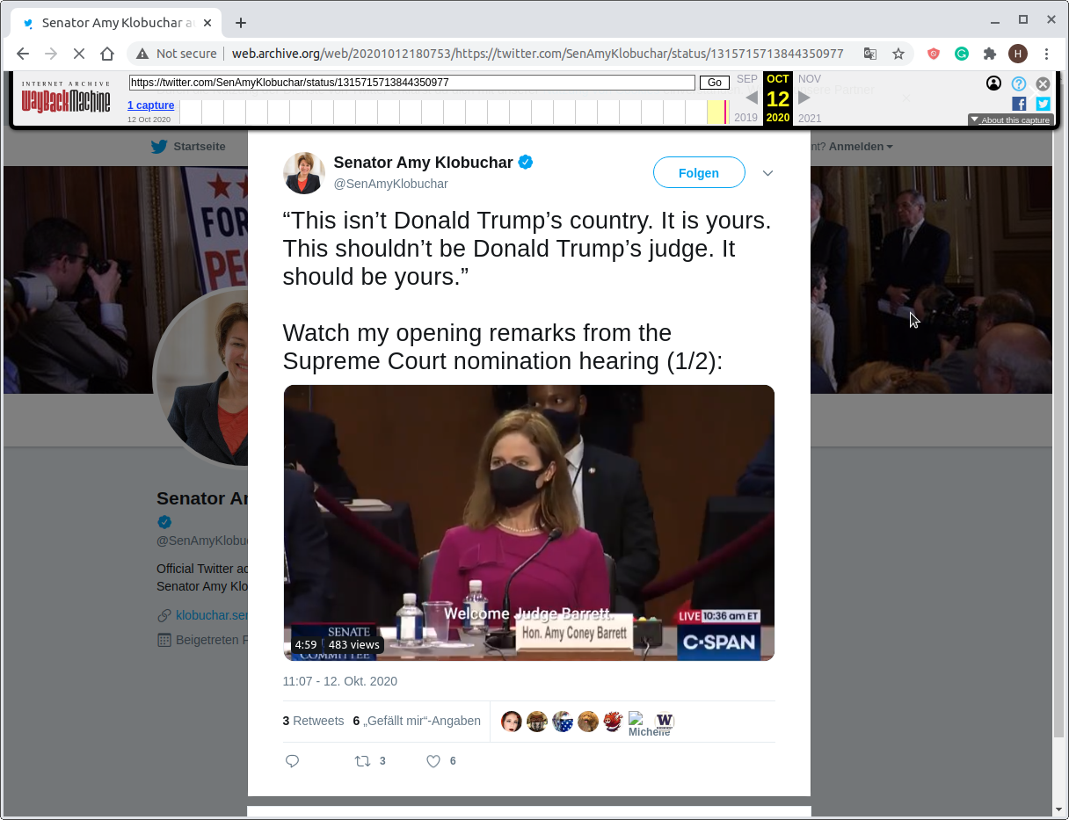
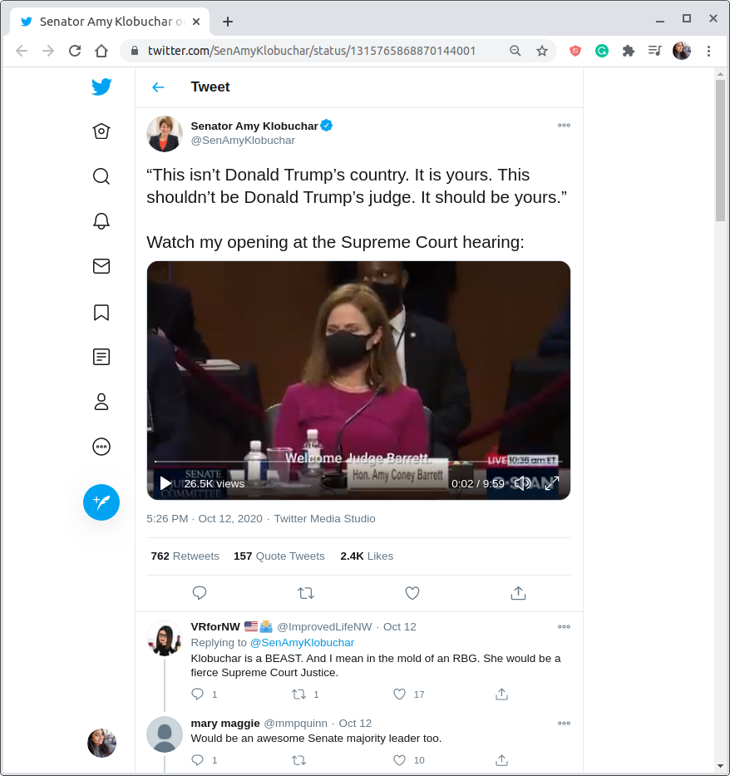
Category 1: Replaced with another tweet
Replacement Tweet
http://web.archive.org/web/20201012180753/https://twitter.com/SenAmyKlobuchar/status/1315715713844350977
https://twitter.com/SenAmyKlobuchar/status/1315765868870144001

Slide 23
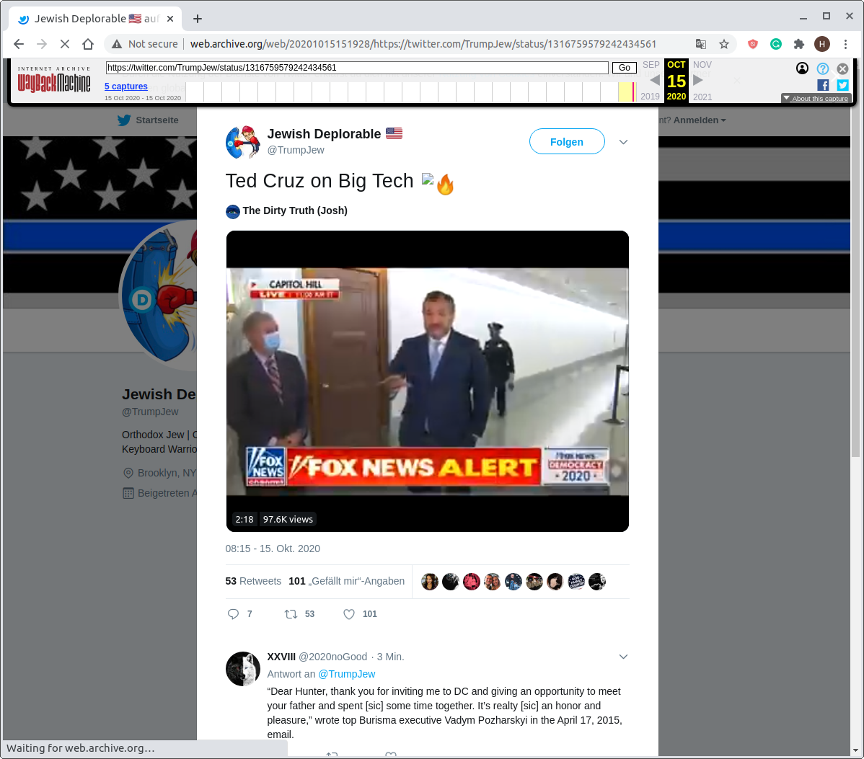
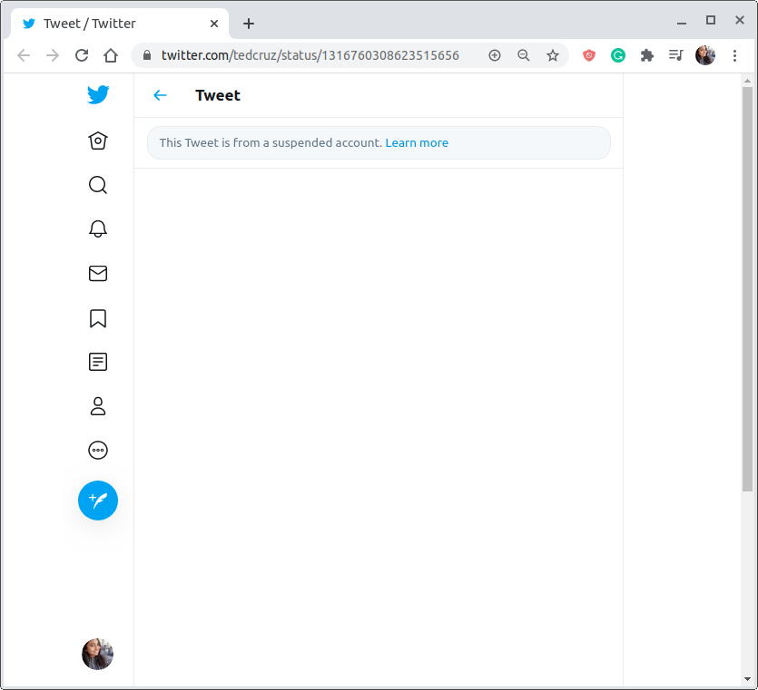
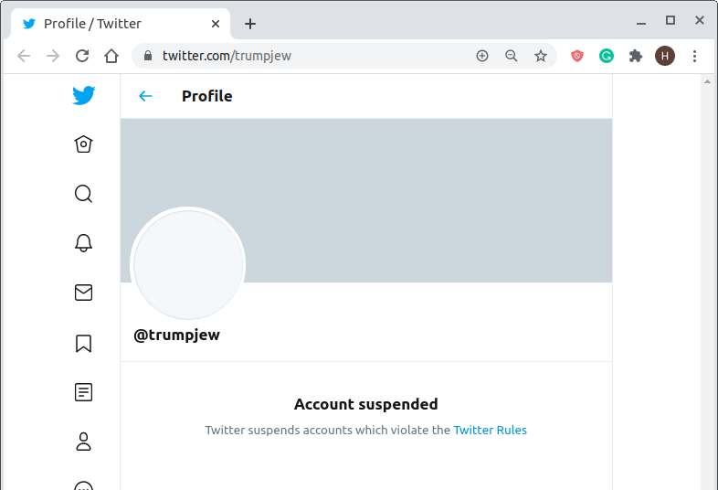
Category 2: RT of something that you don't control
https://twitter.com/tedcruz/status/1316760308623515656
http://web.archive.org/web/20201015151928/https://twitter.com/TrumpJew/status/1316759579242434561
https://twitter.com/trumpjew

Slide 24
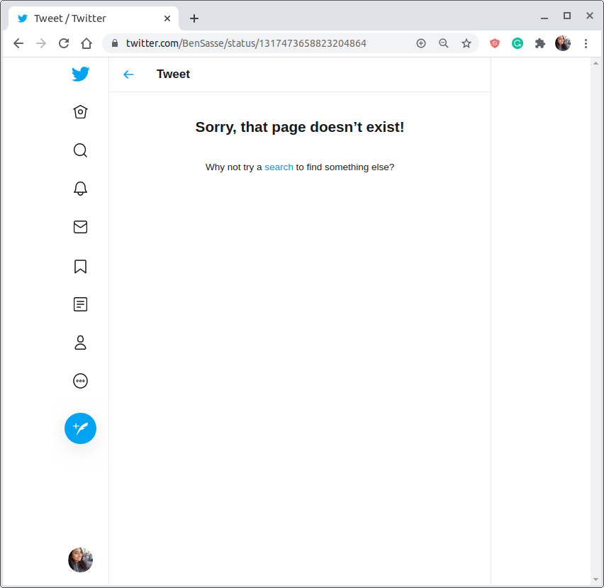
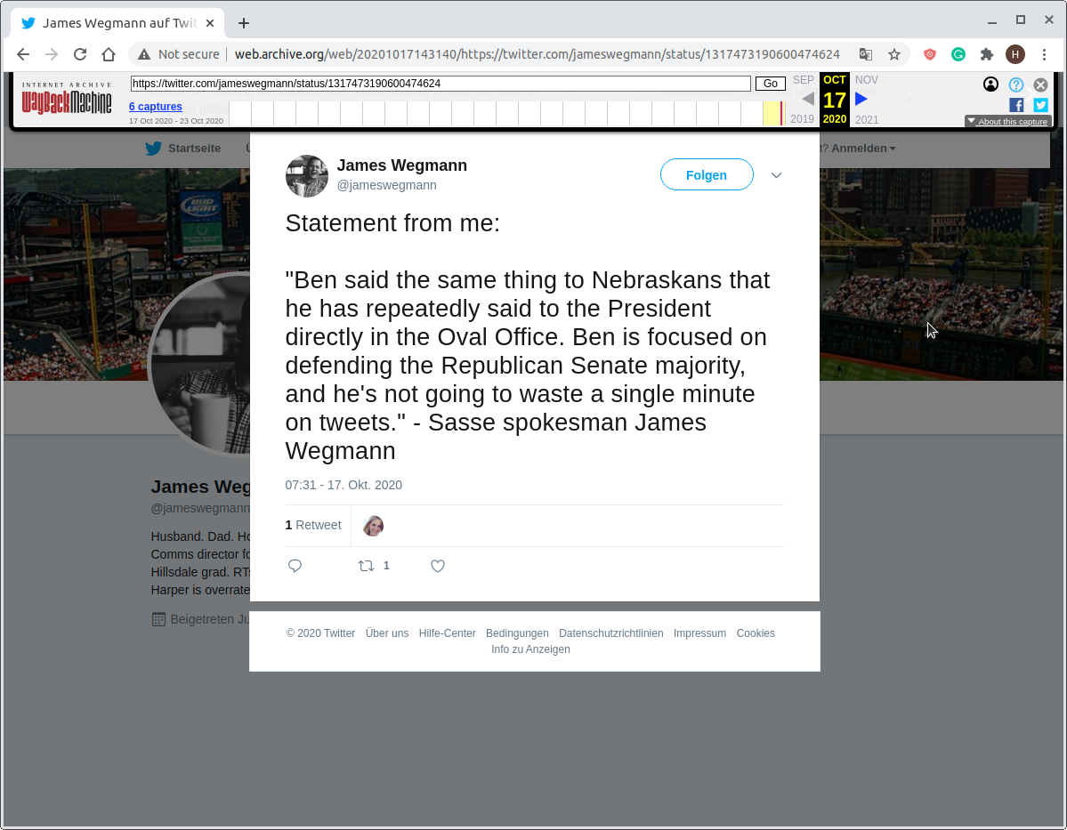
Category 3: UnRTd
UnRTd after a day!
curl -ILs https://twitter.com/BenSasse/status/1317473658823204864 | grep "^HTTP\|content-type\|date:\|expiry\|last-modified:"
HTTP/2 200
content-type: text/html; charset=utf-8
date: Thu, 12 Nov 2020 18:33:26 GMT
expiry: Tue, 31 Mar 1981 05:00:00 GMT
last-modified: Thu, 12 Nov 2020 18:33:26 GMT
https://twitter.com/BenSasse/status/1317473658823204864
http://web.archive.org/web/20201017143140/https://twitter.com/jameswegmann/status/1317473190600474624

Slide 25
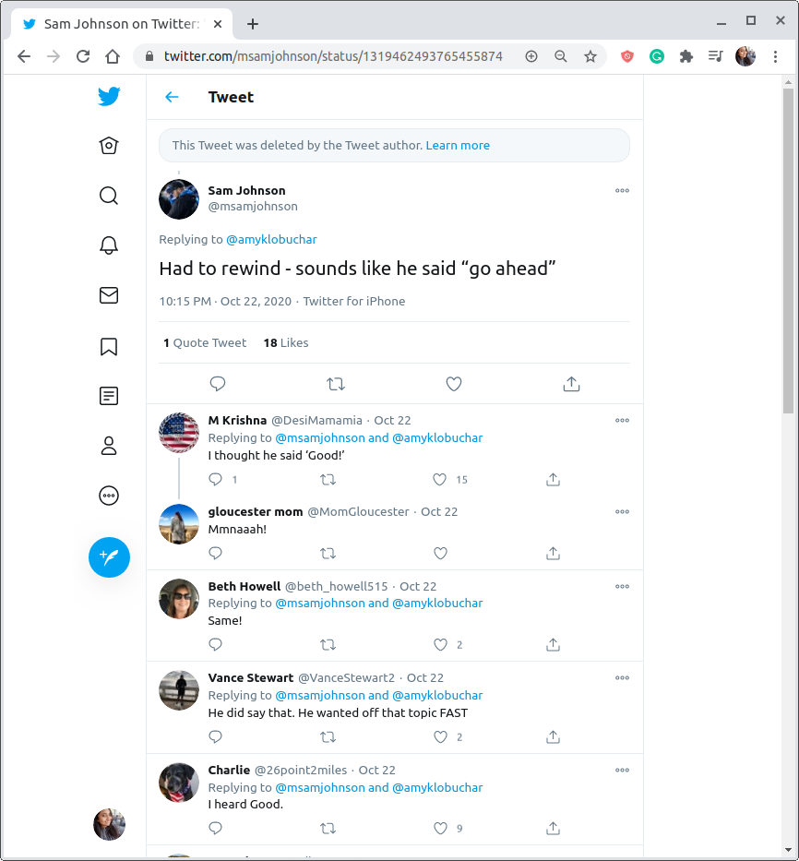
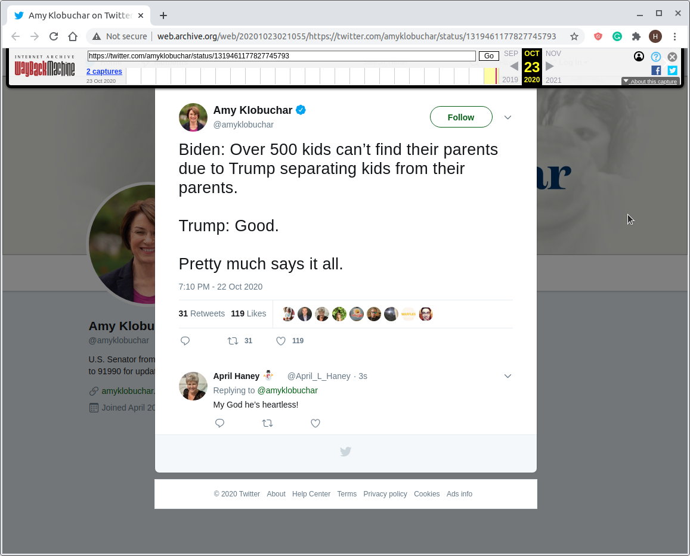
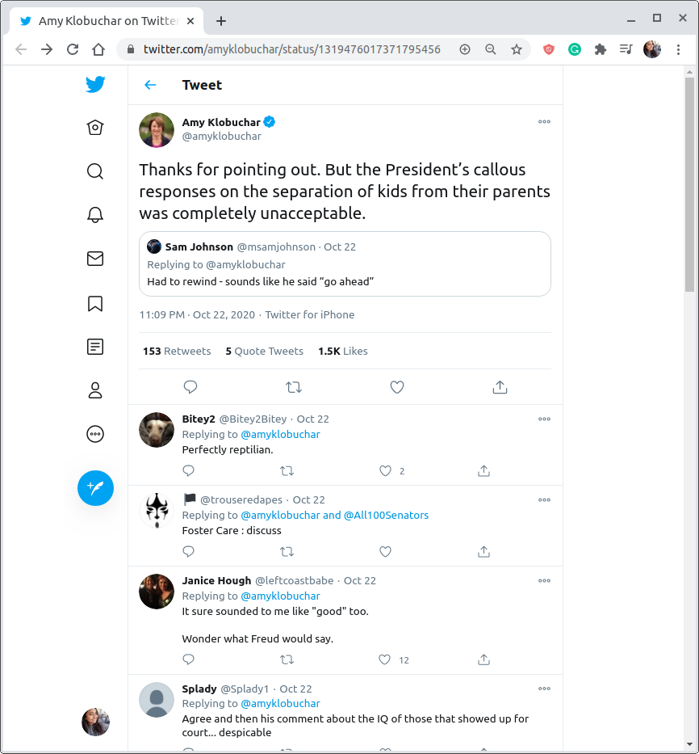
Category 4: Inaccurate information
https://twitter.com/msamjohnson/status/1319462493765455874
http://web.archive.org/web/20201023021055/https://twitter.com/amyklobuchar/status/1319461177827745793
https://twitter.com/amyklobuchar/status/1319476017371795456

Slide 26
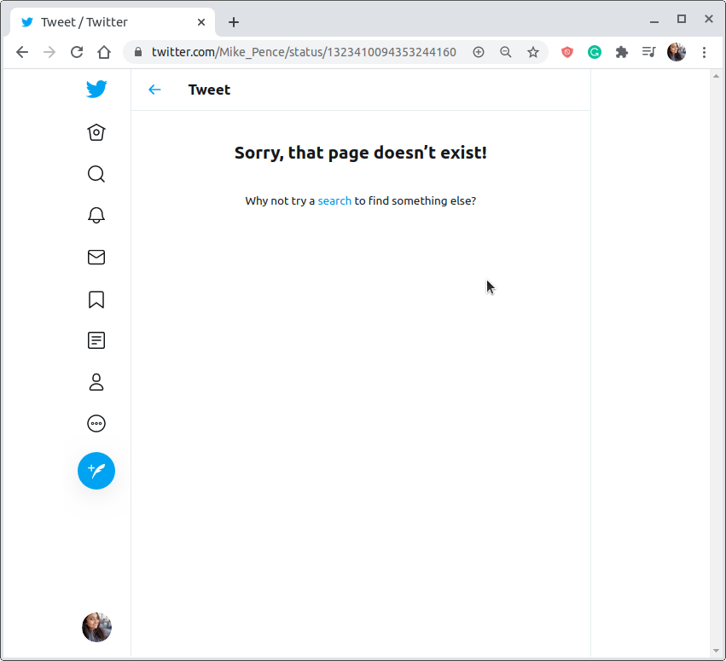
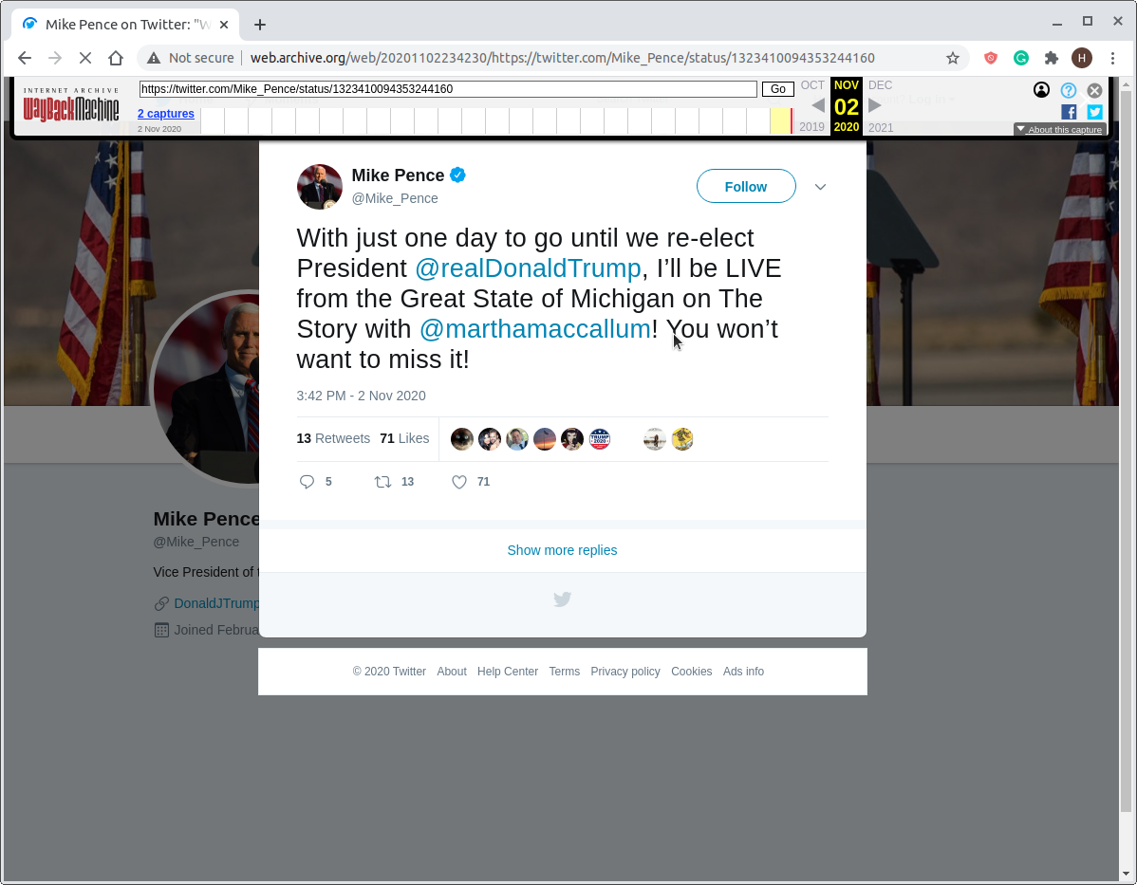
Category 5: Other/unknown
Deleted after an hour!
curl -ILs https://twitter.com/Mike_Pence/status/1323410094353244160 | grep "^HTTP\|content-type\|date:\|expiry\|last-modified:"
HTTP/2 200
content-type: text/html; charset=utf-8
date: Wed, 11 Nov 2020 21:31:21 GMT
expiry: Tue, 31 Mar 1981 05:00:00 GMT
last-modified: Wed, 11 Nov 2020 21:31:21 GMT
https://twitter.com/Mike_Pence/status/1323410094353244160
http://web.archive.org/web/20201102234230/https://twitter.com/Mike_Pence/status/1323410094353244160
Notes:
https://twitter.com/TylerDeva/status/1323410122157125632

Slide 27
Summary of Data
Total Number of Potential Candidates: 18
Total Number of Twitter Accounts: 35
Total Number of Deleted Tweets Found: 19
Account | Official/ Personal | Democrat/ Republic | Deleted Tweets | Deleted After (Avg)
tedcruz | P | R | 5 | 2 weeks
Mike_Pence | P | R | 4 | 2 hrs
BenSasse | P | R | 3 | 17 hrs
amyklobuchar | P | D | 3 | -
SenAmyKlobuchar | O | D | 2 | -
SenTedCruz | O | R | 1 | 2 days
GovRonDeSantis | O | R | 1 | 2 days
Category | Tweets
Replaced with another tweet | 6
RT of something that you don't control | 4
UnRTd | 5
Inaccurate information | 2
Other/unknown | 2
Table1: Candidates >= 1 deleted tweet, in the order of number of deleted tweets
Table2: Summary of deleted tweets that fall under each category

Slide 28
Key Takeaways:
We can find deleted tweets of a particular user with the use of web archives , given that the user’s account is popular enough to be well archived.
Out of the 18 potential candidates, five of them have at least one deleted tweet between Oct 1, 2020 to Nov 9, 2020.
Most of the time when a user deletes a tweet, that tweet gets replaced with another tweet which may have closely related content or same content with slight corrections.
There can be overlap between the categories. Ex: UnRT can fall into any other category depending on why the user decided to UnRT.

